Slide 1
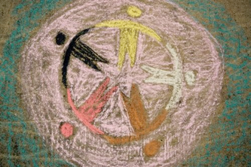
Biblical Unity in a Divided World

Slide 2
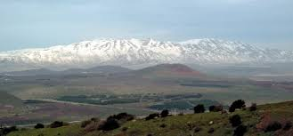
Biblical Unity
Ps. 133
How good and pleasant it is when God’s people live together in unity!
It is like precious oil poured on the head, running down on the beard, running down on Aaron’s beard, down on the collar of his robe. It is as if the dew of Hermon were falling on Mount Zion. For there the Lord bestows his blessing, even life forevermore.

Slide 3
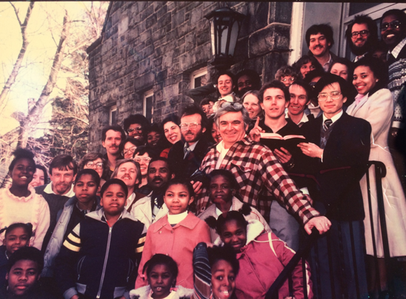
Biblical Unity
John 17:22-23
I have given them the glory that you gave me, that they may be one as we are one— I in them and you in me—so that they may be brought to complete unity. Then the world will know that you sent me and have loved them even as you have loved me.
Faith Christian Fellowship 1983

Slide 4
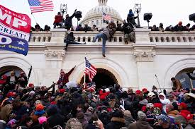
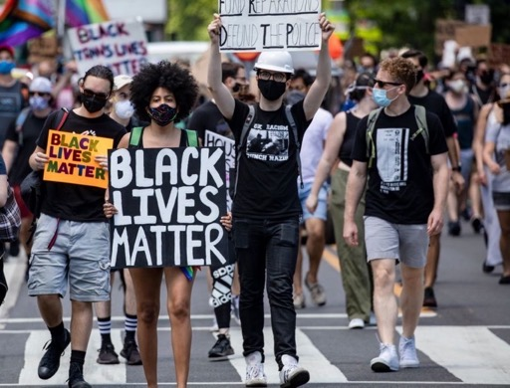
Our Cultural Moment
Increased political polarization
Increased racial awareness and unrest, esp. since George Floyd’s death
Multiethnic participants
While primarily peaceful, a minority on both sides have reacted violently (Charlottesville, Minneapolis, Seattle, Portland, the Capitol)

Slide 5
Our Cultural Moment

Slide 6
Our Cultural Moment in the Church
Exodus of some POC from White evangelical spaces (Lecrae, Jemar Tisby, Dwight McKissic)
Denominations (Southern Baptists, PCA) addressing issues of CRT and White supremacy
POC race exhaustion and White defensiveness
Deficiencies of multicultural church
Labeling: “right” and “left”, “progressive” vs. “conservative”

Slide 7
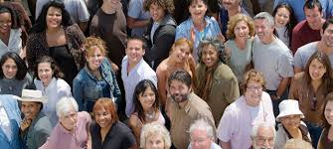
The World We’re Called to Reach: Demographics
“… the 2020 census will tell us that we are a more racially diverse nation than at any point in our history. And the fact that racial minorities hold an even bigger presence among our younger generations suggests that diversity will be the calling card of the nation’s demography in the 21st century, in ways that will have a lasting impact on our economy, politics, and society.”
William Frey, Senior Fellow
Metropolitan Policy Program

Slide 8
Baltimore Region – 10 mile radius

Slide 9
Baltimore Region – 10 mile radius

Slide 10
Baltimore Region – 30 mile radius

Slide 11
Baltimore Region – 30 mile radius

Slide 12
The World We’re Called to Reach
 | Rev. Dr. Bryan Chapell
Loss of Truth | what’s true to me; truth for the moment)
Loss of Youth | 2/3 of evangelical youth will stop going to church when they leave home
Loss of Family Consistency | 38-50% of marriages break up
Loss of the Mature | Loss of denominational ancestry/job-marriage-retirement- life transitions
Loss of Church Attendance | encroaching competition: sports, jobs, travel, vacation homes most common attendance pattern for those who are regular is 3/8 Sunday
Effect: There is little difference between those who identify themselves as believers and those who do not. 50% premarital sex 1/3 alcohol addiction in one White evangelical denomination.

Slide 13
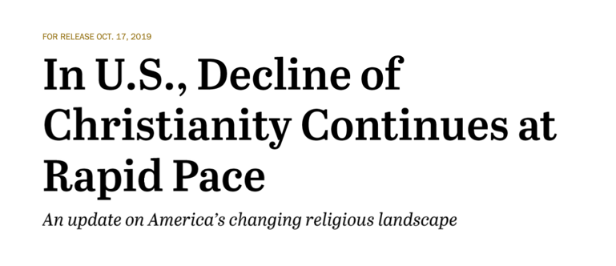
Religious Identity in the US

Slide 14
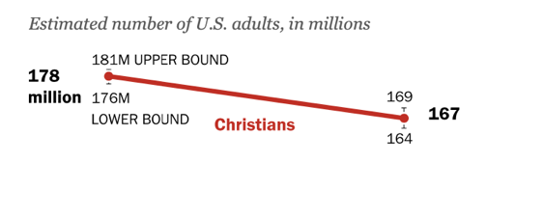
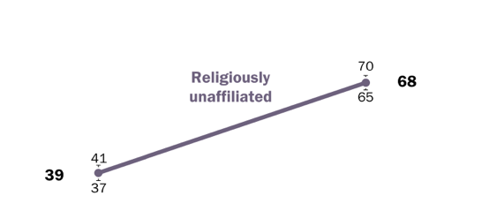

Slide 15
Generational Culture Divides
50 and Above | shared | 40 and Below
Heroes Jerry Falwell Pat Robertson Jim Kennedy James Dobson | Francis Schaeffer Chuck Colson | Heroes Tim Keller Ed Stetzer Russell Moore
Perspective of the other side: You are compromisers. You are cowards. You are capitulating to the culture |  | Perspective of the other side: You identified the church with politics and this led to cultural rejection. You have no compassion. You are hypocrites; you talk about the gospel but are not willing to carry it into the culture.

Slide 16
Generational Culture Divides
50 and Above | 40 and Below
Moral Majority: we need to take control of the culture to stop the erosion. Need to halt ____. | We’re Christian minorities in a pluralistic society; we don’t take control but instead make the gospel credible to an unbelieving culture. Not what you HALT but what you HELP gives credibility.
Abortion Homosexual agenda Pornography Illegal drugs Gambling Tree huggers= liberal agenda Illegal immigration | AIDS care & missional conversations Sexual trafficking and addiction Opioid crisis Gaming addiction Creation care Refugee care racial fairness is # 1 social issue
Defining experience: preparing for atom bomb attack; | Defining experience: preparing for an Active shooter; adults may not remember Vietnam War or 9/11

Slide 17
The New Testament Context
Jesus Came Into a Similarly Divided Culture
His disciples: Zealots vs tax collector (one who wanted to overthrow Rome vs. a collaborator with Roman occupiers)
Jews vs. Gentiles
Jews vs. Samaritans
Acts 6

Slide 18
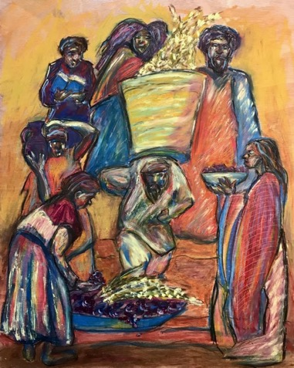
Case Study of Cultural Division: Acts 6
In those days when the number of disciples was increasing, the Hellenistic Jews among them complained against the Hebraic Jews because their widows were being overlooked in the daily distribution of food…
This proposal pleased the whole group. They chose Stephen, a man full of faith and of the Holy Spirit; also Philip, Procorus, Nicanor, Timon, Parmenas, and Nicolas from Antioch, a convert to Judaism. They presented these men to the apostles, who prayed and laid their hands on them.
So the word of God spread. The number of disciples in Jerusalem increased rapidly, and a large number of priests became obedient to the faith.
Image: Twitter, Freedom Rd

Slide 19
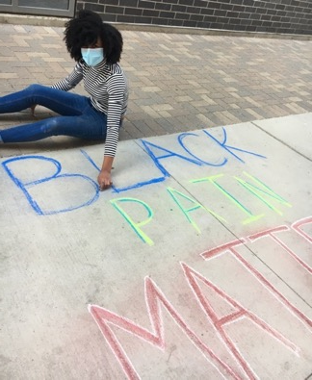
Biblical Discernment: Contemporary Issues & the Gospel
John 17:15 “My prayer is not that you take them out of the world but that you protect them from the evil one. ”
Rom. 12:2 “Do not conform to the pattern of this world, but be transformed by the renewing of your mind. ”
1 Pet 3:15 “But in your hearts revere Christ as Lord. Always be prepared to give an answer to everyone who asks you to give the reason for the hope that you have. But do this with gentleness and respect..”
Importance of defining vocabulary: definitions are fluid and changing rapidly
“Ending racism” and “creating justice” mean different things to different people.
We need to think in Biblical categories: we recognize and reject evil anywhere.
Notes:
NOT erasing but discerning; “…with gentleness… 1 Pet.3:15
“Not everyone who talks about ending racism and creating justice means the same thing. For a growing number of people, including some Christians with good motives, these goals are shorthand for an ideology that divides instead of reconciles, that sees people as either oppressed or oppressor rather than as divine image bearers created from ‘one blood.’” “What Do We Do with Critical Theory? Racism, White Privilege, and Christianity”
Breakpoint 6/17/2020

Slide 20
A Biblical Worldview vs. a Secular Worldview
Current Hot-Button Issues
Christian Nationalism
Critical Race Theory
Black Lives Matter
racial justice
immigration
systemic racism
social justice
White supremacy
White privilege
intersectionality
All truth is God’s truth
common grace
God’s Word
Secular humanism

Slide 21
Is “Social Justice” Biblical?
The term “social justice” is sometimes co-opted by Marxists.
It is a fluid concept right now.
Rejecting the concept outright robs Christians of the chance to become part of the conversation.
We can validate biblical principles of justice and help shape the way in which the cultural conversation develops.
Dr. Kelly Hamren, Liberty University
as quoted in Christianity Today article by Ed Stetzer

Slide 22
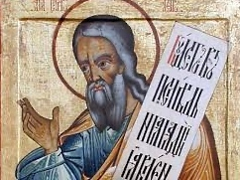
Social Justice
“Our ecclesial-historical amnesia is so acute, our Old Testament literacy so anemic, and our cultural intelligence so low, that we associate social justice with Karl Marx rather than the Prophet Isaiah…”
“The Church of Individualism”
Brad Edwards, mereorthodoxy.com

Slide 23
Biblical Justice: a Few Examples
“Do justice, love mercy, walk humbly with God” | Micah 6:8
Laws of gleaning cared for the poor | Deut. 24:17-22
”Same rules for foreigner as for the native born” | Lev. 24:22
No “unjust scales” | Amos 6:5-6
Don’t show partiality | James 2
Concern for the powerless | Is. 1:17; Ps 41:1; Prov. 31:8-9
Care for foreigners, orphans, widows | Zech. 7:9-10; Jer. 22:3, Deut. 15:7
Sanctity of human life in the womb | Ps. 139:13-16

Slide 24
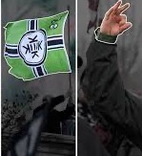
What Does “White Supremacy” Mean?
1: the belief that the white race is inherently superior to other races and that white people should have control over people of other races 2: the social, economic, and political systems that collectively enable white people to maintain power over people of other races Merriam-Webster
Racial dominance problem is SIN, not SKIN. “All have sinned and fall short of the glory of God…” Rom. 3:23
Racial dominance is a human problem: trans-Atlantic slave trade; Hutus vs Tutsis; Uighurs in China; Armenian Genocide; the Holocaust; apartheid in South Africa; Jim Crow laws; etc.
In US, Whites have historically had more power and have set up laws and policies that favored them.

Slide 25
White Privilege
Secular perspective | Biblical Worldview
“White people receive certain societal benefits that they did not earn, but receive by default simply by being white.” | Acts 6: Hebraic widows received preferential treatment because of structures, not intent.
White people receive the benefit of the doubt; they are not stopped by police because they ‘look like someone’ or are a potential threat. | James 2: God does not show partiality. All people should be treated equally under the law. Because we’re all sinners, we’re all capable of unconscious bias. 1 Sam. God looks on the heart, not appearance
White people need to recognize their privilege, acknowledge the guilt of their race, and be “woke.” | The solution is the gospel. We’re all sinners. I am not individually responsible for what others do; however am responsible if I don’t reject/speak against evil when I see it. Nehemiah and other prophets asked forgiveness not only for his sin but the sins of his people and forefathers. (Neh.1)
Notes:
For example, sin and its effects can be addressed on both individual and societal levels. Meeting with a desperate woman outside a clinic and convincing her not to end her baby’s life is addressing it at the individual level. Are there larger, structural problems that make women feel they can’t continue their pregnancies? Better policies of parental leave? Funding for adoptive and social services?

Slide 26
Examples of White Privilege
I consistently see my race represented in textbooks, in Young Adult books, fiction, advertising, movies, etc.
I can generally count on police protection in my community rather than police harassment.
I can safely assume no one will call police on me for jogging in a different neighborhood, or sitting in Starbucks, or entering my own home.
I have parents/grandparents/ancestors who were able to accumulate a nest egg of some type because of favorable government policies.
I can detach from dangerous stereotypes associated with my race; I don’t worry that everyone will think I’m just like Dylan Roof/etc.
Traffic stops don’t frighten me; I have not had to give my teenage sons “the Talk” about what to do if stopped by police while driving.

Slide 27
Critical Race Theory
Tenets of CRT | Biblical Worldview
Systemic racism exists and is created by socio-economic forces. The way to change people is to change society… | Like all sin, racism begins in the heart. (Gen. 3, Rom. 5). “It might be aggravated by circumstances, but circumstances don’t cause sin…” “If sinners build a society, “that society will be structured in ways that reinforce whatever sins dominate the hearts of those who build it… generations later, those structures might still perpetuate the problems...”
Power exists, and people use it to oppress others. | Often true; See Pharaoh, Nebuchadnezzar, etc. 6 of God’s 10 Commandments deal with how we treat others. Depravity of man, yet common grace; The “Greatest Commandment”
Our gender, race, sexual orientation, are our defining characteristics. | Imago Dei is our defining characteristic. God created each of us uniquely; our identity as children of God defines us. However, we are deeply shaped by our gender, race, background, etc.
In each of the above areas, we are either oppressed or oppressors. | Oppression exists (Rom. 3:23) but CRT is reductionistic. It overlooks individual choices and life situations.
Notes:
For example, sin and its effects can be addressed on both individual and societal levels. Meeting with a desperate woman outside a clinic and convincing her not to end her baby’s life is addressing it at the individual level. Are there larger, structural problems that make women feel they can’t continue their pregnancies? Better policies of parental leave? Funding for adoptive and social services?

Slide 28
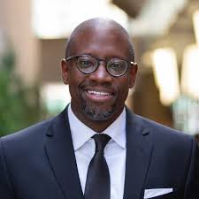
Critical Race Theory
“I need not wholly accept or reject secular frameworks for understanding reality. I can eat the meat and spit out the bones…
“CRT is attempting to give an account of evil and salvation… instead of the resurrection of Jesus Christ, CRT simply wants to dismantle racism in an attempt to achieve cosmic salvation …. anti-racism will set us free….
“CRT is a reductionistic theory of human evil and suffering… it is woefully inadequate to explain the nature of reality …. There is racism in America and …that racism can take on structural forms. It is proper to the work of the church to actively seek to bring solidarity and peace where there is racial conflict because of the hope of the Resurrection.”
Dr. Anthony Bradley, Professor of Religious Studies, The King’s College
Theologian-In-Residence, Redeemer Presbyterian Church

Slide 29
Black Lives Matter (organization vs. slogan)
Tenets of BLM Organization | Biblical Worldview
Organization is built on atheistic foundation | In the beginning God created the heavens and the earth.” Gen. 1:1; The Shema, (Deut 6)
“queer and trans affirming “ | God created all humanity in imago Dei, male and female (Gen. 1:27). All are worthy of dignity and respect, all impacted by the fall. God ordains marriage between a man and a woman; Jesus affirmed this.
Marxist, socialist | Promotes willing generosity, not mandated distribution
The BLM Slogan | Biblical Worldview
Statistically, Black people have disproportionately experienced violence from law enforcement and others. | All humans are created in imago Dei, image of God. No partiality; same rules for all people; no “unjust scales” of justice
We call attention to this and work for reforms. | God calls his people to live justly. (Micah 6:8) Our lives should reflect his priorities and principles.
Notes:
For example, sin and its effects can be addressed on both individual and societal levels. Meeting with a desperate woman outside a clinic and convincing her not to end her baby’s life is addressing it at the individual level. Are there larger, structural problems that make women feel they can’t continue their pregnancies? Can’t afford to raise a child alone? Better policies of parental leave? Funding for adoptive and social services? Better access to training/higher education for low-income people?

Slide 30
Intersectionality
Current Worldview | Biblical Worldview
“The interconnected nature of social categorizations such as race, class, and gender, …[create]overlapping and interdependent systems of discrimination or disadvantage.” Oxford Dict. | In a fallen world, “Various types of structural sin can intersect in ways that cause a ‘multiplier effect’.” (Gospel Coalition)
Overlapping identities provide layers of either privilege or discrimination. | Ruth & Naomi: female, poor, Moabite/widow & elderly. Samaritan woman
Creates sub-genres of victimization, which often compete for victimhood. | “What gives us our identity is not color or culture. But chosenness. “ John Piper
…”it ceases to be an insight and becomes an ideology. … can be used to promote the flourishing of the human community or …to create new forms of systematic sin… the concept has frequently… been used as a tool for building division …between the “oppressors” (i.e., white males) and the oppressed (i.e., almost everyone else) (Gospel Coalition) | While characteristics such as race and gender are not erased when a person becomes a member of God’s kingdom, our identity as Christians is rebuilt around Jesus. As the apostle Peter says, “you are a chosen race, a royal priesthood, a holy nation, a people for his own possession “ (1 Pet. 2:9) We retain these characteristics in the New Jerusalem.

Slide 31
Practical Steps
“Eat the meat, spit out the bones”
Be careful about media sources; read both “liberal” and “conservative” outlets.
Is all your info coming from people who look like you, think like you, are part of your culture? If so, you’re missing a large part of the Kingdom. Listen to other voices. Fight cultural isolation.
To increase your capacity to engage hard issues, live deeply in the gospel.
Find a healing gospel community in which to process gospel theology.
Gaze at God, glance at the problem; gaze at scripture, glance at news (and pray)
Run ideas/information through a gospel perspective, not “right” or “left”; think biblically.
Be aware of our tendency to have our beliefs and behavior dominated by culture: “Jonah theology” .

Slide 32
Q and A
Which of these issues is most pressing for you right now?
What do you think your members are struggling with most?
What helps people think biblically about these issues?

Slide 33
Resources: The Intercultural Development Inventory® (IDI®)
“Cultural Intelligence is the ability to function effectively across various cultural contexts.”
Widely used by businesses, universities, and denominations
Assesses cross-cultural competence on a continuum from a monocultural mindset to a global mindset
Receive customized individual, group, or organization-wide IDI profile reports
All Individual IDI profile reports accompanied by customized Intercultural Development Plans
Notes:
Cross Cultural Validity: In clinical research, the degree to which the performance of the items on a translated or culturally adapted health related–patient reported outcomes (HR-PRO) instrument are an adequate reflection of the performance of the items of the original version of the HR-PRO instrument.... ...
Back translated: Back translation is not merely translating back and forth. -Back translation is defined as: a procedure whereby a translator (or team of translators) interpret or re-translate a document that was previously translated into another language, back to the original language.
-Large sample size
-Social desirability: viewed well by others for their answer
-Content validity: measures what it says it will
-Predictive validity: predicts performance
-Construct Validity: Measurement is able to measure what it says it will.
1.The IDI has demonstrated value and effective use across cultural communities.
2.To further illustrate this: show group the short (2 minute) video case studies found at idiinventory.com

Slide 34
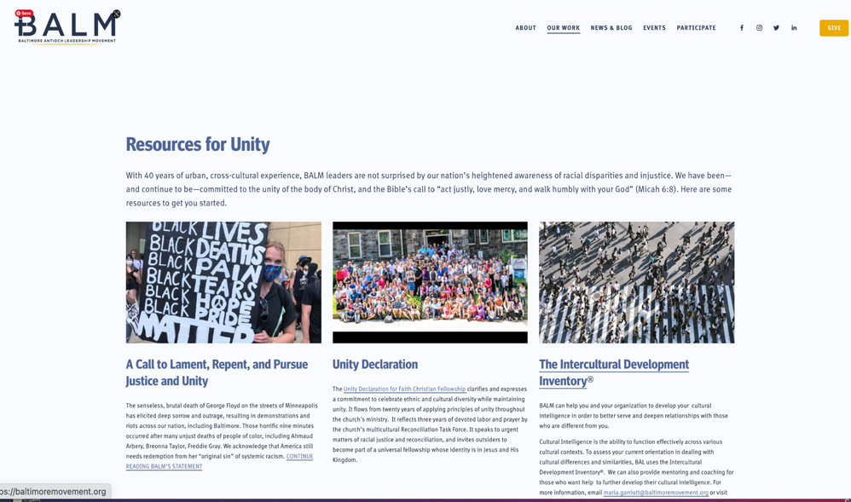
Resources

Slide 35
BALM exists to raise Christ-centered,
cross-cultural disciple-making leaders for
Baltimore and beyond.
www.baltimoremovement.org

